Slide 1




Limiting Access to User Information
Yoel Kortick. Senior Librarian
https://www.askideas.com/20-amazing-sunset-view-pictures-and-images-of-charles-bridge/

Slide 2
Limiting access to user information
It is possible to limit operators with certain user roles from accessing other users' information by blocking the operators' ability to search for patron information.
When this function is enabled, the standard user search field is replaced by a text entry field.
This means that the ID can still be entered or scanned in, but the auto complete function on the following functions are hidden:
  Name search
  Find and Manage Users pickup list
  Recent searches button

Slide 3
Limiting access to user information
Operators with the following roles can be restricted:
  Circulation Desk roles - Manager, Operator, and Operator - Limited
  Fulfillment Services roles - Manager and Operator
  Requests Operator
By default, this function is disabled. To enable it, contact Ex Libris Support.

Slide 4
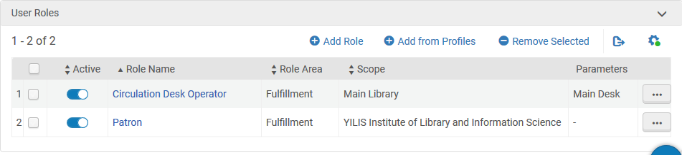
Limiting access to user information
Currently user Donald Draper has role “Circulation Desk Operator” for the “Main Library” for the “Main Desk” in institution ‘YILIS Institute of Library and Information Science’

Slide 5
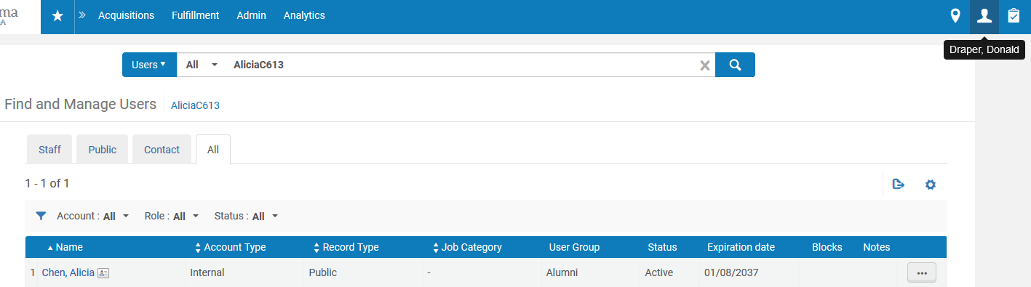
Limiting access to user information
From the repository search Donald can search for user “Alicia Chen” by the “primary identifier”

Slide 6
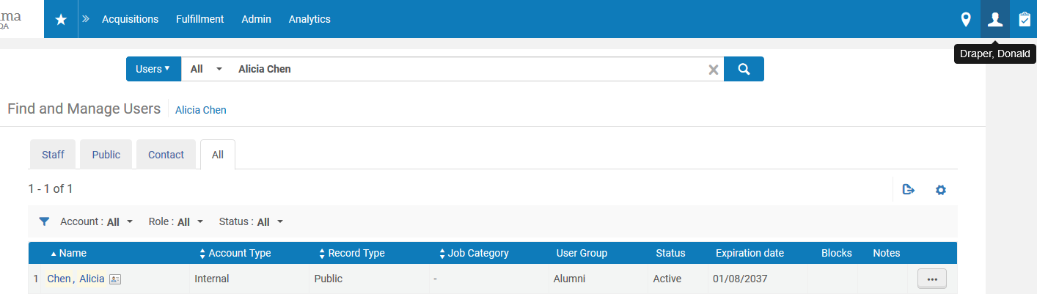
Limiting access to user information
From the repository search Donald can search for user “Alicia Chen” by the name

Slide 7
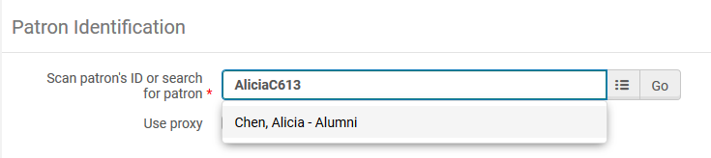
Limiting access to user information
From the manage patron services Donald can search for user “Alicia Chen” by the “primary identifier”

Slide 8
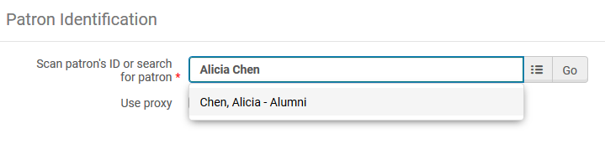
Limiting access to user information
From the manage patron services Donald can search for user “Alicia Chen” by the name

Slide 9
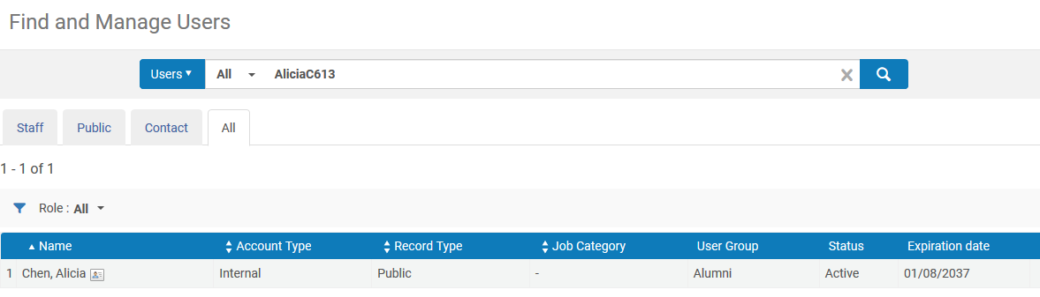
Limiting access to user information
From the manage patron services pickup list Donald can search for user “Alicia Chen” by the “primary identifier”

Slide 10
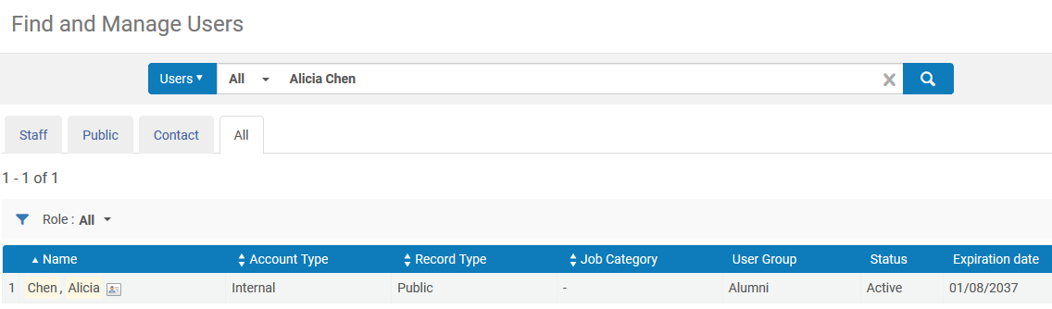
Limiting access to user information
From the manage patron services pickup list Donald can search for user “Alicia Chen” by the name

Slide 11
Limiting access to user information
As a result of an institution requesting from Ex Libris support to limit this functionality one or more of these roles may be changed:
  Circulation Desk roles - Manager, Operator, and Operator - Limited
  Fulfillment Services roles - Manager and Operator
  Requests Operator

Slide 12
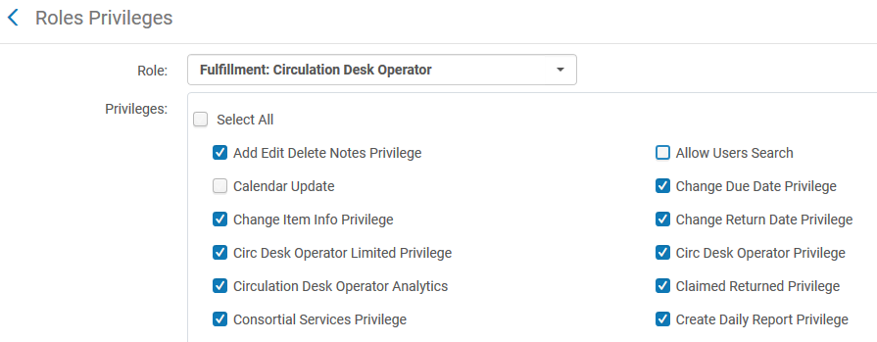
Limiting access to user information
Here we have changed the role “Circulation Desk Operator” (the role which Donald Draper has) and removed the check next to “Allow Users Search”

Slide 13
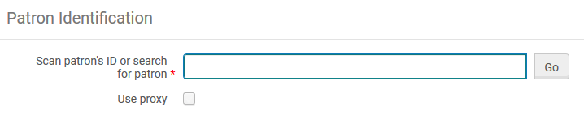
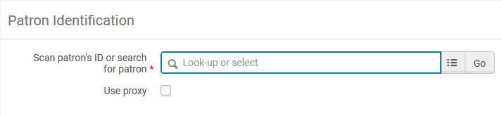
Limiting access to user information
Now in the manage patron services there is no longer a link to the pickup list
Previously Donald Draper had this
This pickup list link to search for the users has disappeared.

Slide 14
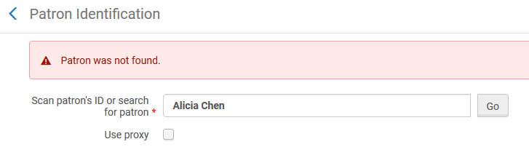
Limiting access to user information
Now in the manage patron services the name cannot be used to retrieve the patron

Slide 15
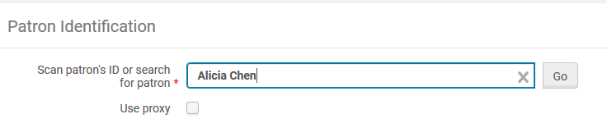
Limiting access to user information
And now in the manage patron services the name cannot be used to cause the AJAX to bring suggestions

Slide 16
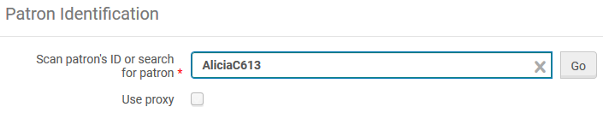
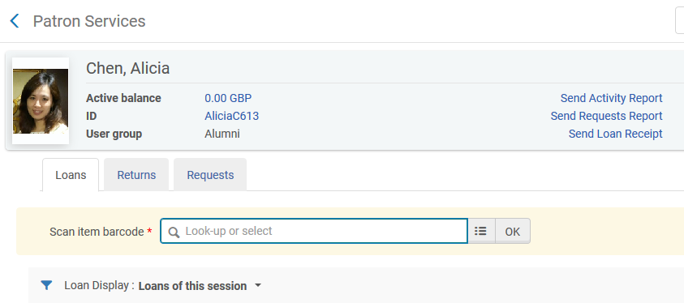
Limiting access to user information
And now in the manage patron services only the ID can be used to retrieve the patron

Slide 17
Limiting access to user information
But … Donald can still search for Users from the repository search

Slide 18
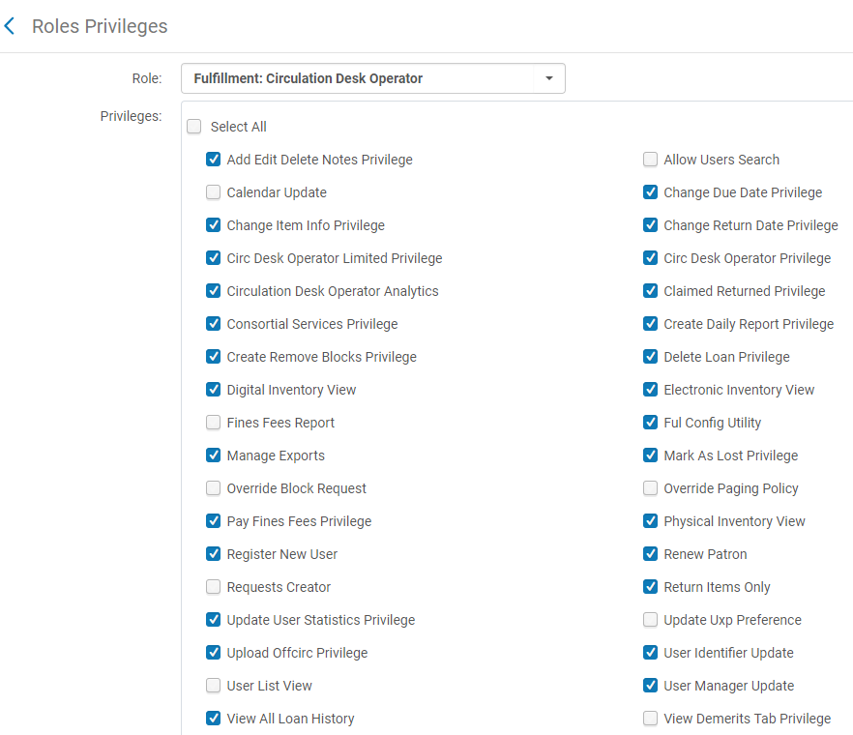
Limiting access to user information
If we want to remove the repository search of patrons then we also need to have the “User List View” removed from the “Circulation Desk Operator”

Slide 19
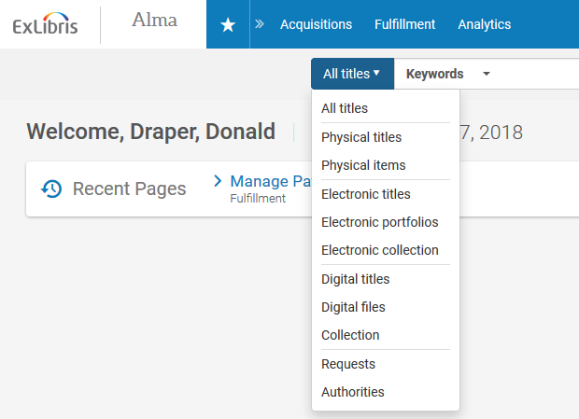
Limiting access to user information
Now Donald Draper has no option to search the repository for users.
No option here to search by user

Slide 20
Thank You
Yoel.Kortick@exlibrisgroup.com
https://www.askideas.com/20-amazing-sunset-view-pictures-and-images-of-charles-bridge/

